Slide 1
Image Converter (To text, speech format)
Syed Obaid Ullah Hussain 1604-19-733-106
Syed Mustafa Ahmed Hashmi 1604-19-733-109

Slide 2
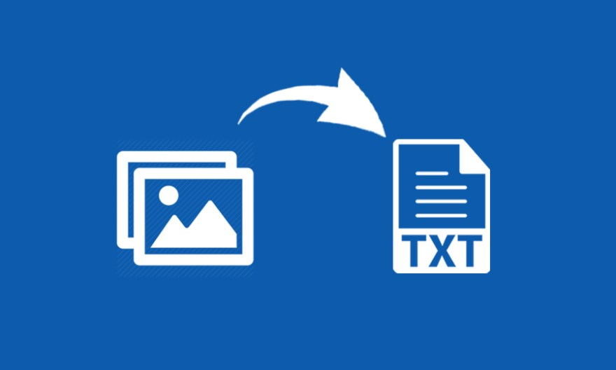
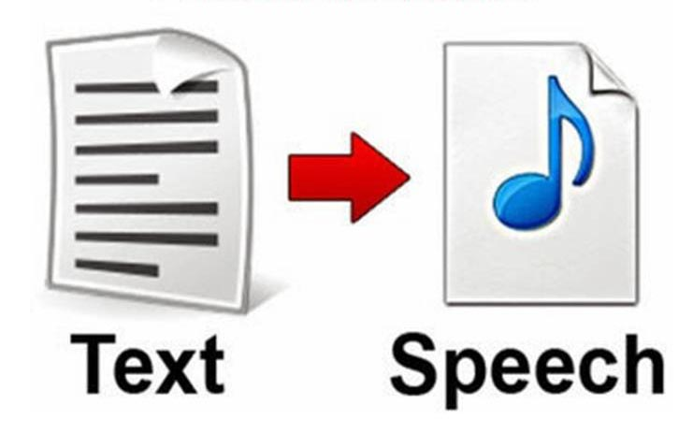
What is Image Converter?
Web app which scans the given image and return back the text which was written on it.
It can also read out loud the text message with the given voice feature.

Slide 3
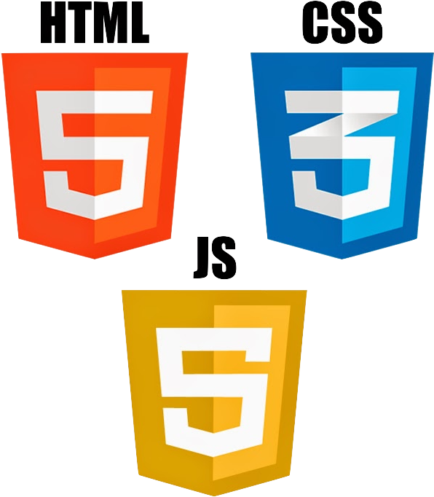
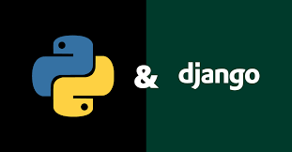
What we used to make it ?
For Front End
HTML
CSS
JAVASCRIPT
For Back End
Django written in Python
Python Libraries

Slide 4
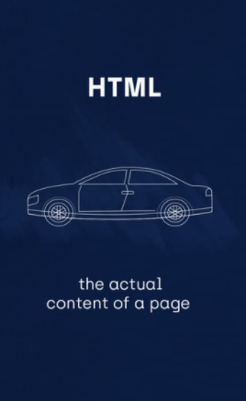
What is HTML?
the code that is used to structure a web page and its content.
e.g. content could be structured within a set of paragraphs, a list of bulleted points, or using images and data tables.

Slide 5
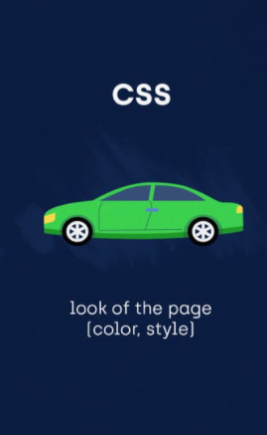
What is CSS?
used for defining the styles for web pages.
the look and formatting of a document.
generally used with HTML to change the style of web pages and user interfaces.

Slide 6
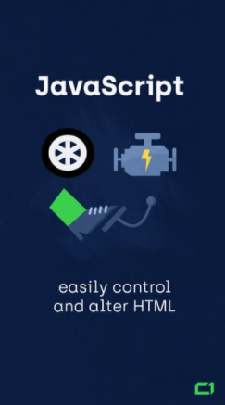
What is JavaScript?
is a text-based programming language used both on the client-side and server-side.
gives web pages interactive elements that engage a user.

Slide 7
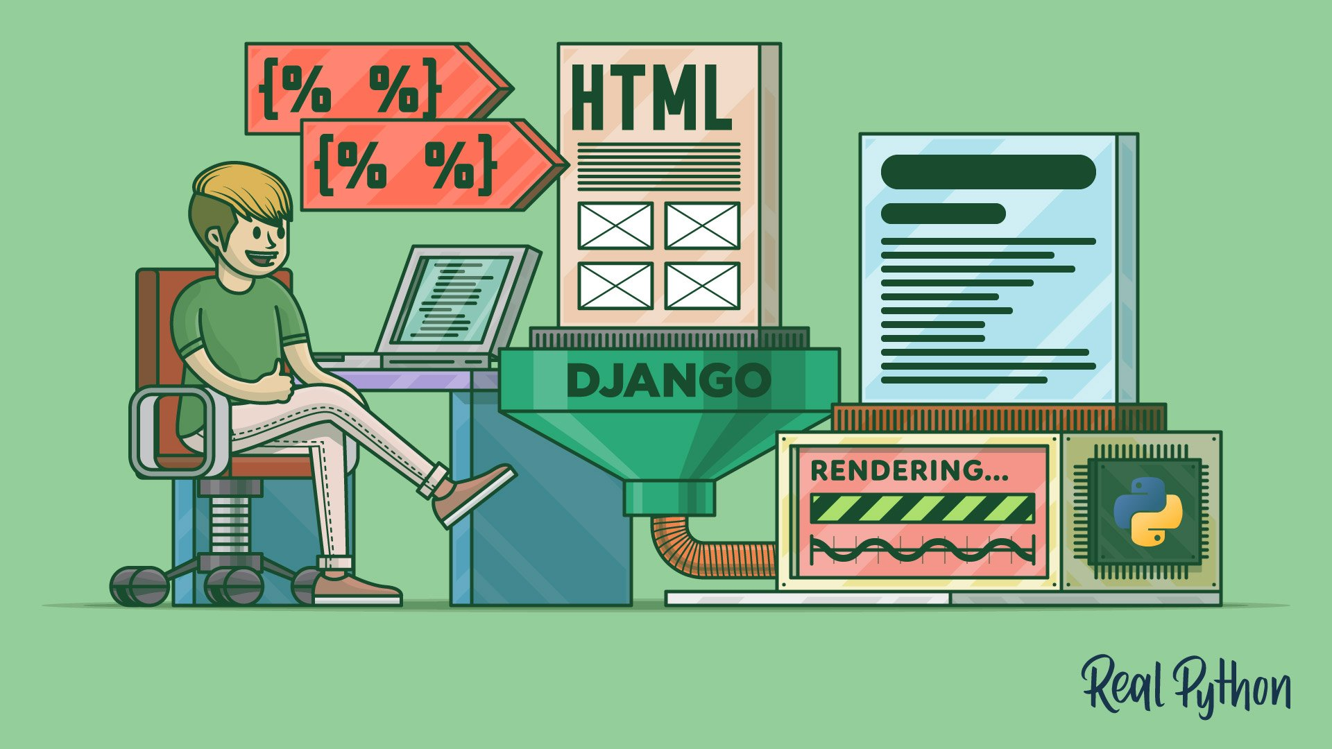
A little bit about Django ….
Python-based free and open-source web framework.
follows the model–template–views architectural pattern.

Slide 8

Continue…
Django is a collection of Python libs allowing you to quickly and efficiently create a quality Web application.
is suitable for both frontend and backend

Slide 9
Different libraries we used
Pytesseract
is a wrapper for Tesseract-OCR Engine.
useful as a stand-alone invocation script to tesseract.
read all image types supported by the Pillow libraries, including jpeg, png, gif, bmp, tiff, and others.

Slide 10
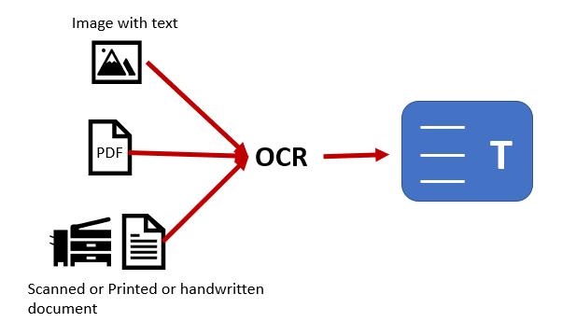
Optical character recognition or reader (OCR)
electronic or mechanical conversion of images of typed, handwritten or printed text into machine-encoded text.

Slide 11
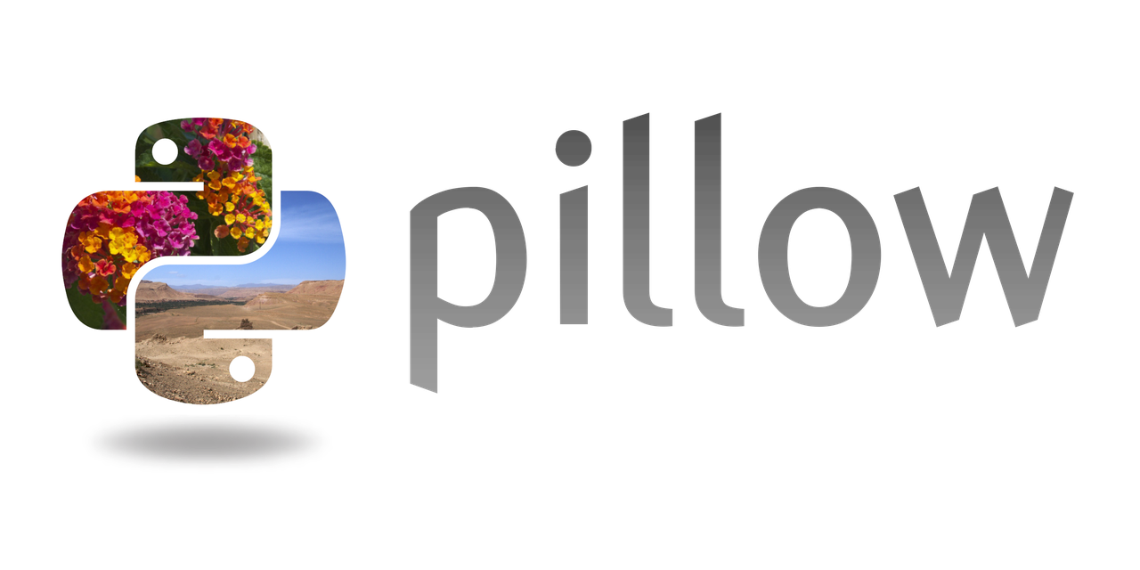
Python Imaging Library (PIL)
a free and open-source library for the Python.
adds support for opening, manipulating, and saving many different image file formats.

Slide 12
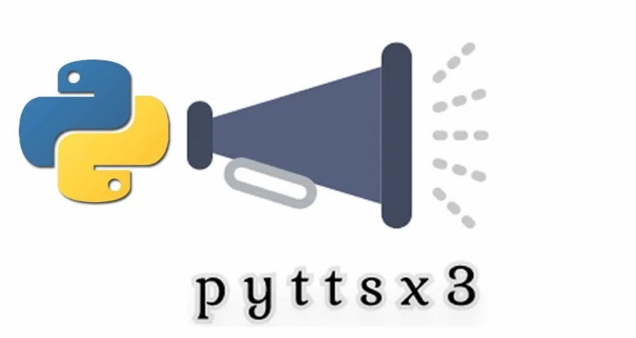
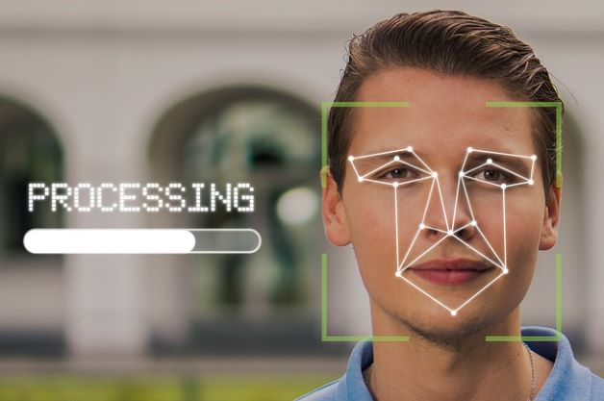
Pyttsx
is a Python package supporting common text-to-speech engines.
OpenCV-Python
is a library of Python bindings designed to solve computer vision problems.

Slide 13
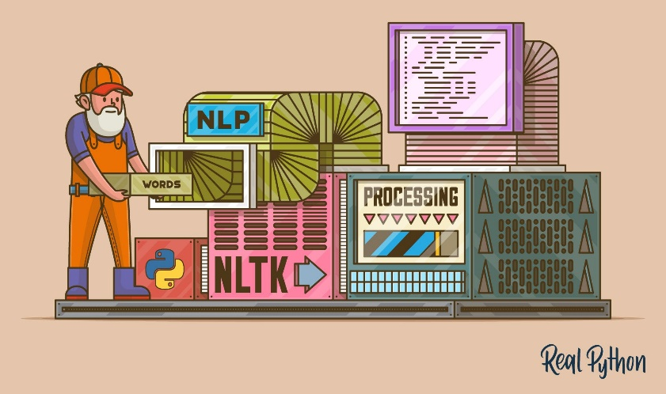

Natural Language Processing
The Natural Language Toolkit or NLTK
is a suite of libraries and programs for symbolic and statistical natural language processing for English written in the Python programming language.

Slide 14

Reason why we chose it…….
With the development of technology, the content of image is needed in text format in cases of registrations which include information passing where only some part of information present in the image is required.
Typing the whole thing or the extraction of audio from text this audio being properly delivered is very time consuming as well difficult, and thus this is the best solution which we have come up with.

Slide 15
Conclusion
The Use of the afore mentioned libraries and the techniques proved to be very beneficial especially in terms of logic which can be understood with ease.
The Natural language Processing usage has brought the audio format to a very excellent height of understanding where sentences and words were separated accordingly.
Many more improvements are still possible such as sentiment analysis where humor, sarcasm is identified using advanced Natural language Processing.

Slide 16
Let your ideas and thoughts
give you inspiration. All
creativity comes from your
imagination - you first
imagine and then you create.
Thank You

